Slide 1
IoT Remote Vehicle for Hazardous Zone Exploration.
Team members:-
rishivarun Nedunoori - btech-iii(Cse-(ai&ML)), JNTUHUCEM
Srikanth arige – btech-iii(Cse-(ai&ML)), JNTUHUCEM

Slide 2
Problem Statement:-
Safety Risks: Mining areas and other hazardous zones pose dangers such as toxic gases and extreme temperatures, making it unsafe for humans.
Limited Human Accessibility: Certain areas in mines or disaster zones are too dangerous or difficult for direct human entry.
Real-time Monitoring: Lack of an effective system to remotely monitor environmental conditions like gas levels, temperature, and structural integrity.
Communication Issues: Traditional methods may not provide a reliable communication system for controlling vehicles in remote locations.

Slide 3
Solution:-
All sensor data is collected and transmitted to a central control system, where it's processed and visualized in real-time through an online dashboard (like ThingSpeak). The system allows for:
Live Environmental Monitoring:- from any location around the world.
Remote Hazard Detection:- enabling quicker, safer decisions.
Command-Controlled Car:- The vehicle is not just autonomous but also fully manual control-capable, meaning it can be operated remotely to navigate through dangerous zones while continuously transmitting live environmental data.

Slide 4
Market Opportunity:-
Mining Companies – To ensure worker safety and monitor hazardous mining environments in real time.
Disaster Response Teams – For search and rescue operations in disaster-affected areas like collapsed mines or chemical spill zones.
Environmental Agencies – To monitor air quality, gas emissions, and atmospheric conditions in hazardous zones.

Slide 5
Product Demo:-
Technologies Used:-
Hardware Components:-
Raspberry Pi (Microcontroller)– Raspberry Pi 4 Model B
Motor Driver Module – L298N Dual H-Bridge
Temperature Sensor – LM35
Methane Sensor – MQ-4
Carbon Monoxide Sensor – MQ-7
Barometer Sensor – BMP280
Power Bank – 5V, 10000mAh
Software & Programming:-
Python (For sensor data processing and vehicle control)
Thing Speak (For remote monitoring and Data Visualization)
Linux OS (Running on Raspberry Pi)
Product Video :- Link

Slide 6
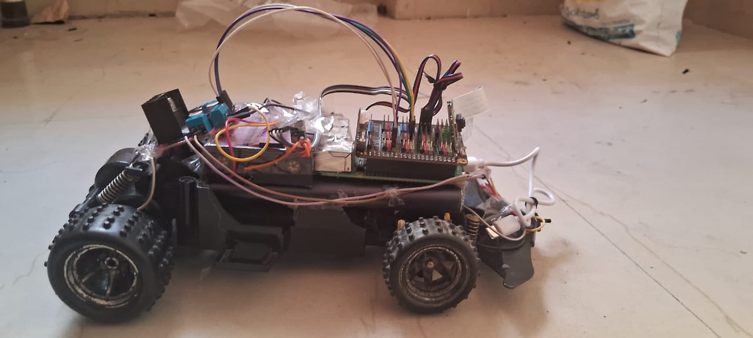
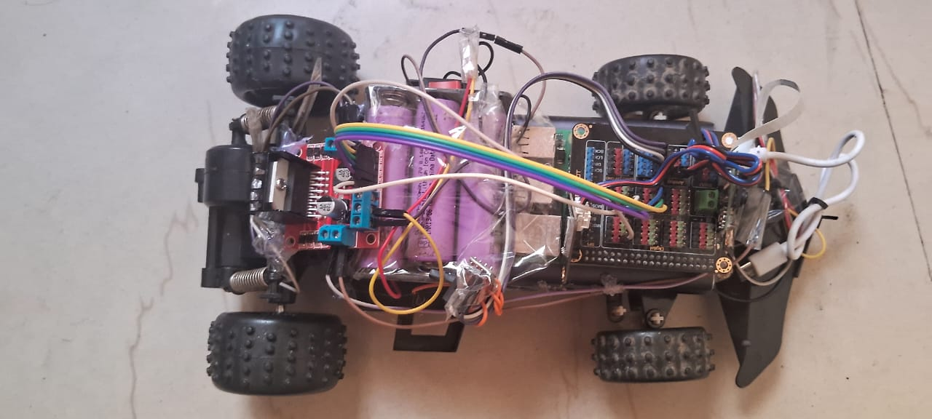
Outcomes:-

Slide 7
Business Model:-
Our business model is structured to scale across various industrial and safety-critical sectors. It includes:
Custom-Built Sales: We aim to manufacture and sell specialized units of our IoT-enabled remote vehicle to industries such as mining, oil and gas, disaster response, and environmental monitoring agencies. Each unit can be tailored based on sensor requirements, terrain needs, and communication preferences (like LoRa or Wi-Fi).
Subscription Services: In future iterations, we plan to offer a cloud-based dashboard with:
Advanced Analytics to interpret environmental trends.
AI-based Predictive Alerts to warn users about potential dangers before they occur.
Remote Multi-Vehicle Management for large-scale deployments.
Maintenance & Upgrades: We’ll provide regular firmware updates, hardware support, and options to upgrade sensors or software modules based on user needs.

Slide 8
Go-To-Market Strategy:-
To successfully bring our innovation to market, we’re adopting a phased strategy:
Pilot Programs:
We will start by offering free or subsidized trials of our vehicle to local mining companies and emergency response teams.
These pilot runs will help us gather real-world data, refine our design, and build trust with initial adopters.
Expos and Tech Competitions:
Participating in engineering expos, tech summits, and student innovation fairs will help us showcase our project to industry leaders and investors.
We aim to gain visibility and attract partnerships from potential collaborators and customers.

Slide 9
Competitive Landscape:-
The robotics and safety monitoring market already includes several products, but our solution stands apart in key ways:
Affordability: Most industrial robots are cost-prohibitive. Our model uses off-the-shelf components like Raspberry Pi and low-cost sensors, making it highly accessible.
IoT Integration: We offer real-time sensor data via cloud platforms, something many legacy solutions lack.
AI & Analytics Readiness: Future enhancements will use machine learning to predict and prevent hazards, providing proactive safety—not just reactive monitoring.
Versatility: Our vehicle can be customized for different environments—mines, tunnels, disaster zones—making it highly adaptable.

Slide 10
Meet the Team:-
Rishivarun Nedunoori– (Software development and remote monitoring)
Skills:- HTML, CSS, Bootstrap, JavaScript, Python, Express, Node.js, Java, SQLite, AI / ML, C, Data Science, NumPy, IoT
2. Srikanth Arige – (Hardware and system integration).
Skills:- Python, Java, SQLite, AI / ML, C, Data Science, NumPy, HTML, CSS, IoT

Slide 11
Call to Action:-
We're looking for mentors, beta testers, and support to take our prototype to the next level integrating AI, cloud analytics, and LoRa communication.

Slide 12
Thank You
JUNICORN and the INTERNATIONAL STARTUPS FOUNDATION(ISF), for believing in our vision and providing the resources to implement it. Special thanks to Mr. Sumit Sartale sir for mentorship during the whole journey.
This means much more than just a project — it is a mission to Enhance the safety measures of mining workers.

